Slide 1
Hadoop Ecosystem
Dr. Naveen Kumar

Slide 2
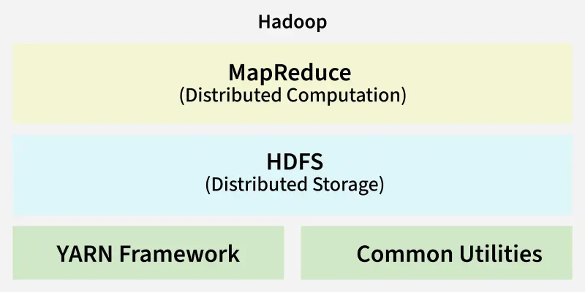

Slide 3
How to start haddop?
Cd /home/username/Hadoop
bin/Hadoop namenode –format
sbin/start-all.sh
Jps
Services:
Namenode
Datanode
Secondarynamenode
nodemanager

Slide 4
HDFS
Hadoop distributed filesystem → store data
Filesystem → Directory → Subdirectory → file → data

Slide 5
Hadoop dfs commands
The hdfs dfs command line utility interacts directly with the Hadoop Distributed File System (HDFS) and shares a nearly identical syntax with standard Linux/Unix shell operations.
hdfs dfs -<command_name> [options] [arguments]

Slide 6
Hadoop dfs commands
📂 Directory & File Management
-mkdir: Creates a new directory.
-ls: Lists files and sub-directories within a specific path.
-touchz: Creates an empty file (0 bytes).
-rm: Deletes a file.
📤 Data Transfer (Local ⇄ HDFS)
-put / -copyFromLocal: Uploads a file or directory from your local machine to HDFS.
-get / -copyToLocal: Downloads a file from HDFS back to your local filesystem.
-getmerge: Combines multiple files from an HDFS directory into a single local file.
-appendToFile: Appends data from a local file directly onto the end of an existing HDFS file.
🔄 Internal HDFS Operations
-cp: Copies a file or folder from one HDFS location to another.
-mv: Moves or renames a file or directory entirely inside HDFS.

Slide 7
Hadoop dfs commands
📄 Viewing & Inspecting Files
-cat: Outputs the full contents of an HDFS file to stdout.
-tail: Displays the final kilobyte of data in a file.
-text: Outputs a source file as plain text, decoding zipped formats automatically. -du: Displays the disk space usage of files and directories.
📊 Disk & System Administration
-df: Shows the total capacity, used space, and remaining space across the entire cluster.
-chmod: Modifies the file access permissions.
-setrep: Dynamically adjusts the target replication factor for a specific path.
❓ Looking for Help?

Slide 8
📂 Directory & File Management
-mkdir: Creates a new directory.
Use -p to automatically create missing parent directories.
-ls: Lists files and sub-directories within a specific path.
hdfs dfs -mkdir /test1
hdfs dfs -ls /
hdfs dfs -ls /test1
hdfs dfs -mkdir /test1/dataa

Slide 9
📤 Data Transfer (Local ⇄ HDFS)
Linux → file.txt
Hdfs – test1/data1 --- keep file.txt here
bin/hdfs dfs -put /home/naveen/file.txt /test1/data1/
bin/hdfs dfs -copyFromLocal /home/naveen/file.txt /test1/data1/
bin/hdfs dfs –ls /test1/data1
bin/hdfs dfs –get /test1/data1/file.txt /home/navee/Desktop/
bin/hdfs dfs –copyToLocal /test1/data1/file.txt /home/navee/Desktop/

Slide 10
📤 Data Transfer (Local ⇄ HDFS)
-getmerge: Combines multiple files from an HDFS directory into a single local file.
-appendToFile: Appends data from a local file directly onto the end of an existing HDFS file.
hdfs dfs -getmerge /user/hadoop/logs/ local_combined_logs.txt
hdfs dfs -appendToFile local_newData.txt /user/hadoop/existing_file.txt
bin/hdfs dfs –ls /test1/data1
bin/hdfs dfs –get /test1/data1/file.txt /home/navee/Desktop/
bin/hdfs dfs –copyToLocal /test1/data1/file.txt /home/navee/Desktop/

Slide 11
📄 Viewing & Inspecting Files
bin/hdfs dfs -lsr /
bin/hdfs dfs -cat /test1/data1/file.txt
bin/hdfs dfs -head /test1/data1/file.txt
bin/hdfs dfs -tail /test1/data1/file.txt
bin/hdfs dfs -rm /test1/data1/file.txt
bin/hdfs dfs –rm -r /test1/data1
bin/hdfs dfs -cat /test1/data1/file.txt | head n 10

Slide 12
🔄 Internal HDFS Operations
Hdfs -- test1/data1/file.txt
Hdfs – test2
hdfs dfs -cp /test1/data1/file.txt /test2
hdfs dfs -mv /test1/data1/file.txt /test2
hdfs dfs -du /test1
hdfs dfs -df -h
hdfs dfs –count /

Slide 13
📂 Directory & File Management
To chech whether file is available
-touchz: Creates an empty file (0 bytes).
hdfs dfs -chmod 755 /test1
hdfs dfs –test -e /test1/data1/file.txt
bin/hdfs dfs -touchz /user/hadoop/empty_file.txt

Slide 14
HDFS Architecture

Slide 15
Datanode crashes

Slide 16
Namenode crashes (passive namenodes)

Slide 17
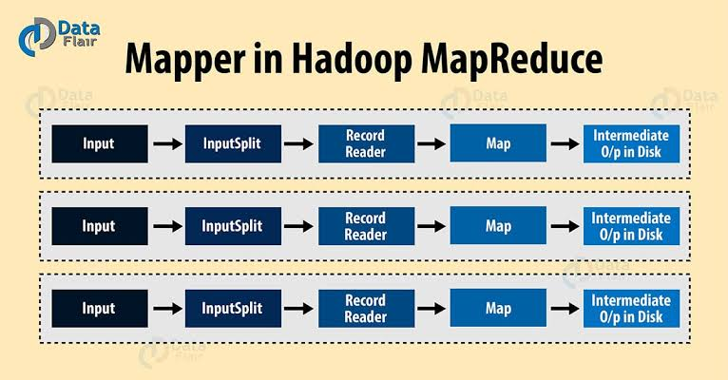
MapReduce Architecture
HDFS → amazon data →

Slide 18
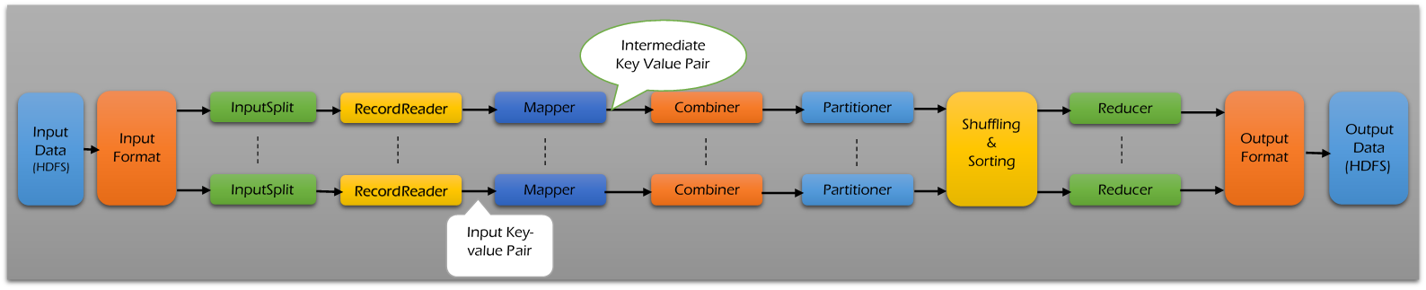

Slide 19
Sqoop installation
Sqoop installation
Sqoop architecture
Sqooop linux commands
sqoop List databases –connect “jdbc:mysql://localhost/” –username root –password admin
List tables
sqoop list-tables –connect “”

Slide 20
Sqoop eval –connect “jdbc…” –username root –password admin –query “insert into newTable values(a, data) ()”
Sqoop eval –connect “jdbc…” –username root –password admin –query “insert into newTable values(a, data) ()”
Import (mysql to hdfs)
Single table
sqoop import --driver com.mysql.jdbc.Driver --connect 'jdbc:mysql://localhost/amity' --username root --password navbharti --table testnew --m 1
All tables
Conditional import
Target directory
Incremental Import

Slide 21
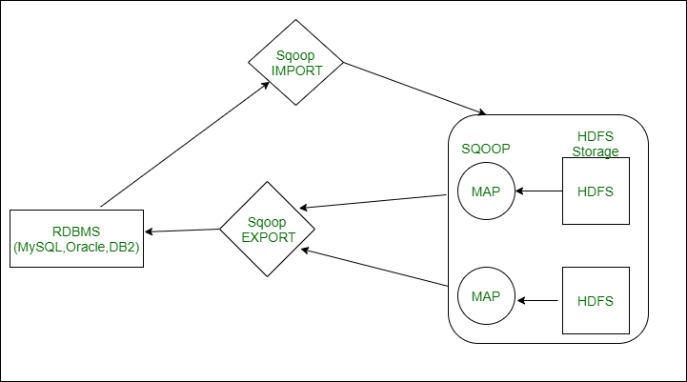

Slide 22
Importing data from MySQL to HDFS
Step 1: Login into MySQL
mysql -u root –p admin
Step 2: Create a database and table and insert data.
Step 3: Create a database and table in the hive where data should be imported.
Step 4: Run below the import command on Hadoop.

